Slide 1
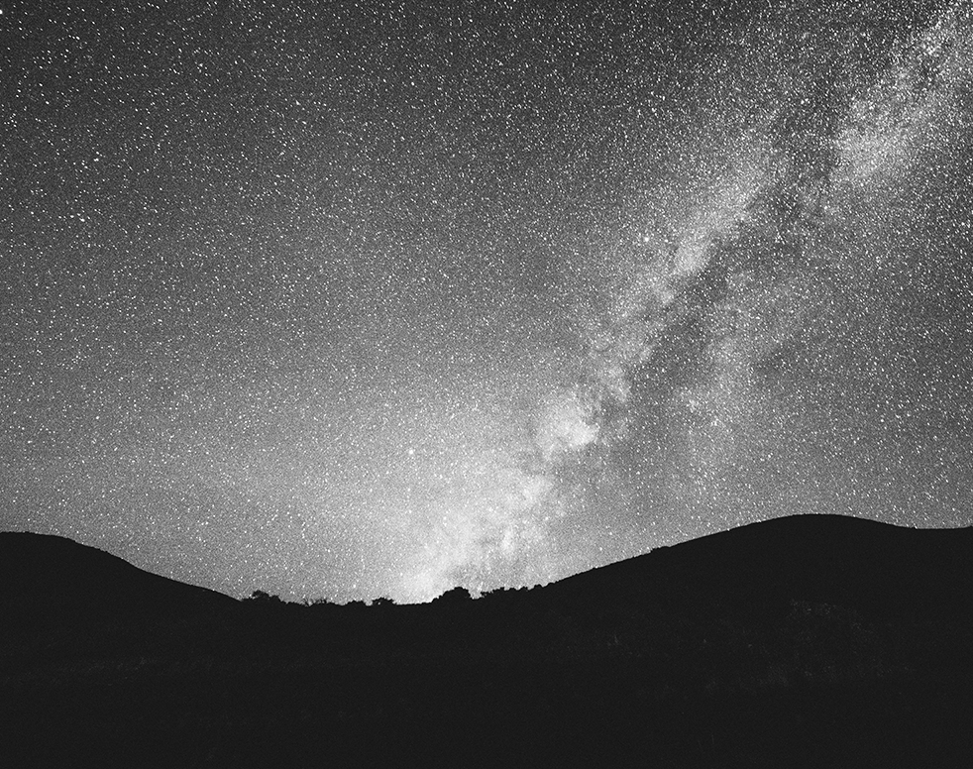

Testing ML and deep learning methods for estimating metallicity for RRL stars
By:
Melika Keshavarzmirzamohammadi
Supervisor :
Giuliano Iorio
This Photo by Unknown Author is licensed under CC BY-SA

Slide 2

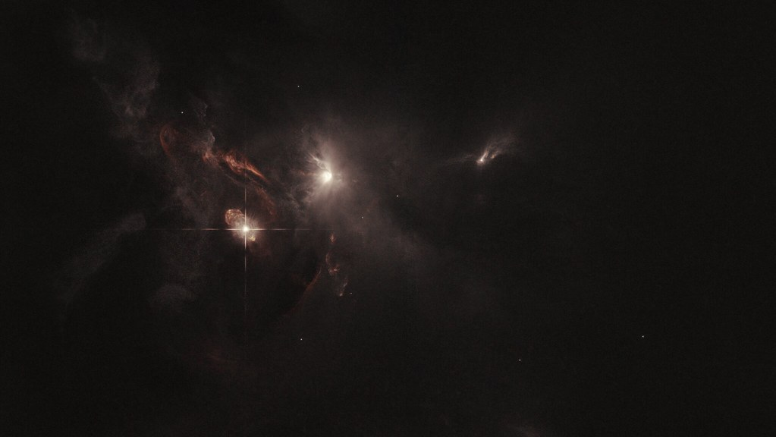
Variable Stars
Any stars whose brightness changes notably in intensity in a time scale of a few hours to more than 100 days are called variable stars. these changes might happen either in a periodic fashion or an irregular one.

Slide 3
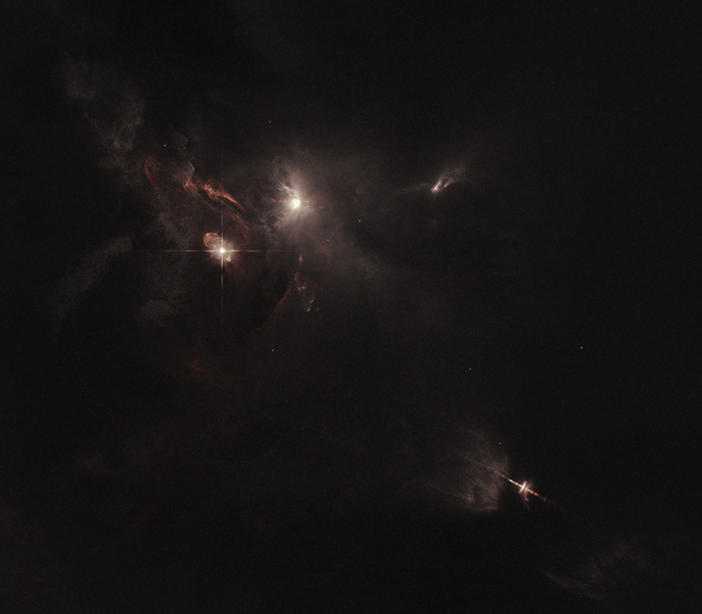
Light curves:
If we sample from the brightness of these stars and plot them over time we arrive at a plot called light curve.
The observation of the light curves can be interrupted:
For ground-based telescopes, interruptions often occur during daylight hours.
For space telescopes, the change of focus interrupts the observations, since these telescopes are designed to scan the entire sky and their focus is not limited to the observation of a single star.
To overcome these interruptions, astronomers piece together the interrupted light curves like a puzzle. They plot the light curve as a function of phase, where phase represents the percentage of the star’s period completed.

Slide 4
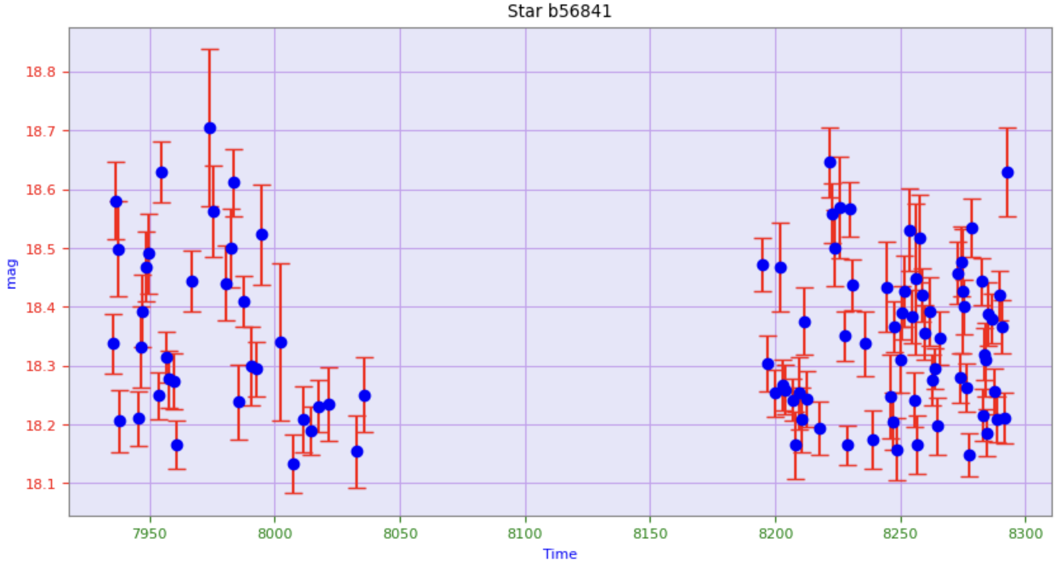
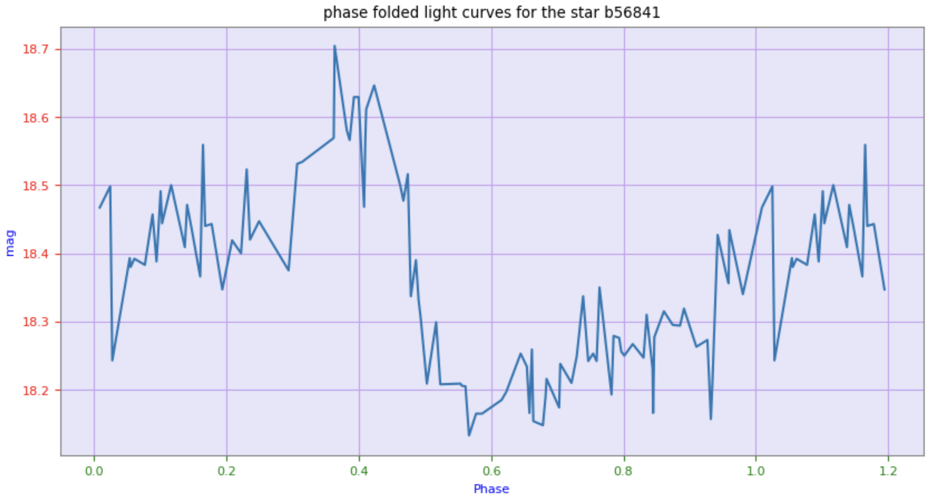


$$φ=\frac{t−E}{P} −integer[\frac{(t−E)}{P}]$$
This is the light curve with respect to time. As we can see the observation was interrupted.
This is the phase folded light curve. One phase, shows the light curve in one phase.
$φ is the phase.$
t is the time of the observation
E is the time of the starting point
P is the period.

Slide 5
Classification For Variable stars:
This classification is based on the period of the pulsation:
Cepheid variables: These stars have periods between 5 and 60 days.
RR Lyrae variables: are similar to Cepheids, but have periods of only 0.5 to 1 day, and can be observed to go from their brightest to faintest magnitude within a single night. they are smaller and less luminous than Cepheids.
Mira variables: long-period or Mira variables have periods longer than 100 days. These stars’ variations are not always as regular or as predictable as those of Cepheids and RR Lyraes.

Slide 6
RRL Stars:
RRLs represent a group of low-mass stars, initially very similar to our own sun; however, through natural ageing, they have depleted hydrogen in their core and now rely on helium core burning and hydrogen shell burning as their power source. They all have more or less the same luminosity, due to the fact that they all leave the Red Giant phase with the same helium core mass (approximately 0.5M⊙).
RRL Classification based on their light curve shapes:
RRL ab: also known as ”fundamental mode pulsators”, are the most common RRL types. They are characterized by light curves with a rapid rise to maximum brightness, followed by a slower decline to minimum brightness.
RRL c: referred to as ”first overtone pulsators”, and they exhibit sinusoidal variations.
RR d: known as ”double-mode pulsators” These stars display a unique feature—double-mode pulsation—meaning they have two distinct periods of variability.

Slide 7
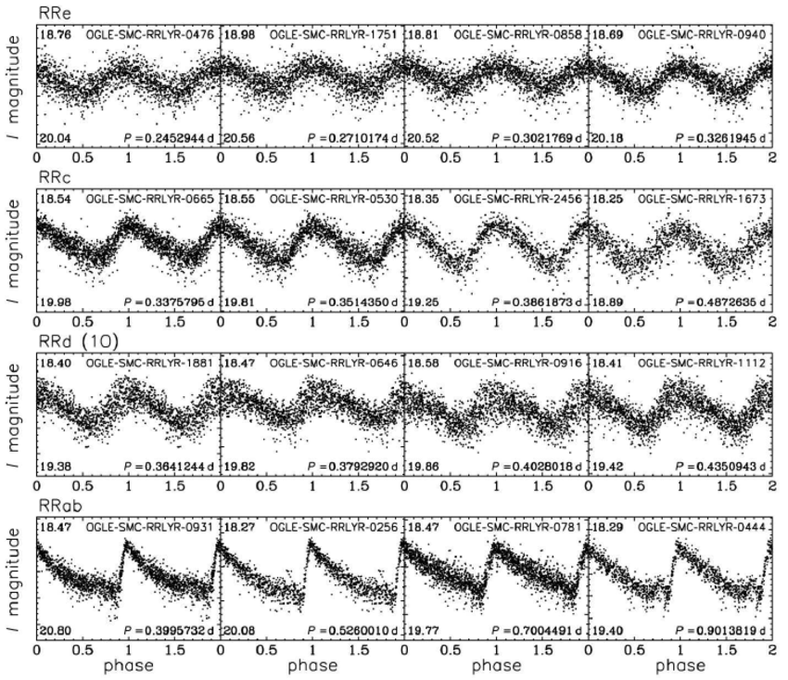
RRL Classification based on their light curve shapes:

Slide 8

Why are they so important to us?

Slide 9
1. Chemical tracers:
variable stars reveal information about the age and chemical composition of stars and the substructure of our galaxy. For example, the presence of certain types of variable stars in a star cluster or galaxy can indicate the age of the stellar population.

Slide 10
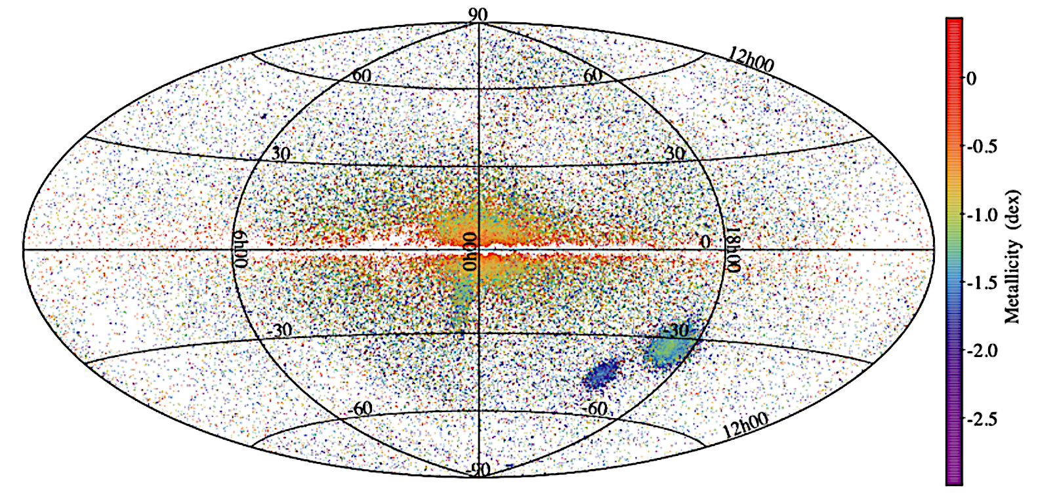
1. Chemical tracers:
Map in galactic coordinates of about 134,000 RR Lyrae stars that will be released in Gaia DR3 for which an estimate of metallicity was obtained from the pulsation period and the φ31 Fourier parameter of the G-band light curve. The sources are colour-coded according to their metallicity ([Fe/H]) as encoded in the colour bar on the right. The two Magellanic Clouds are easily recognized in the bottom-right portion of the map. The Sagittarius dwarf spheroidal galaxy popping out just below to the left from the centre of the map can also be clearly seen. The higher metallicity of the RR Lyrae stars in the Milky Way bulge compared to variables in the Galactic halo can easily be appreciated, as it is also clear the lower metal abundance of the RR Lyrae stars in the Small Magellanic Cloud compared to the variables in the Large Magellanic Cloud

Slide 11

2. Distance indicators:
RRL stars are standard candles. A standard candle is a type of astronomical object whose intrinsic luminosity is well-known. These objects serve as reference points or benchmarks for measuring astronomical distances.
$$M_{I}=a_{I}∗\log\left(P\right)+b_{I}∗\left[FeH\right]+c_{I}$$
Based on the formula mentioned above, precise knowledge of the metallicity, along with the period of the RRL stars, allows for the accurate estimation of their absolute magnitude. By having this absolute magnitude and comparing it to the apparent amplitude, we can then estimate the distance to these stars.

Slide 12
The motivation of this work :
The motivation behind this work stems from the labour-intensive nature of HDS metallicity measurements, which are known for their high accuracy. Given the significant effort required for these measurements, it becomes imperative to develop a reliable alternative for estimating metallicity. Consequently, the primary goal of our study is to establish a trustworthy model for the estimation of metallicity.
In recent literature, there has been a growing interest in leveraging machine learning and deep learning techniques to address this challenge. In our research, we delve deeper into this field by exploring a variety of models. Our aim is to assess their feasibility and accuracy in order to identify the most suitable approach for metallicity estimation.

Slide 13
The motivation of this work :
The objective of this project encompasses three primary facets:
Our goal is to assess the feasibility of estimating metallicity using an efficient machine learning method, such as XGBoost, within a single spectral band.
The second goal is to establish a regression model, utilizing two recurrent neural networks (RNN) architectures, Long Short-Term Memory (LSTM) and Gated Recurrent Unit (GRU), to predict metallicity for the G band light curves from the I band light curves.
Finally, we enhance this regression for the new Gaia data release in the optical G band employing transfer learning methods.

Slide 14

THE DATA ASSEMBLY

Slide 15
Dataset A:
Light curves in the I band and their corresponding G band were obtained for 13,190 stars from OGLE and the second Gaia data release (DR2) respectively.
Dataset B:
95 light curves in the G band from the third Gaia data release (DR3) were used, and their HDS metallicity values were sourced from Crestani et al. (2021)
Dataset C:
2189 light curves in the G band from the Gaia DR2 dataset were used, and their metallicity calculations were derived from the paper by Liu et al. (2020)

Slide 16
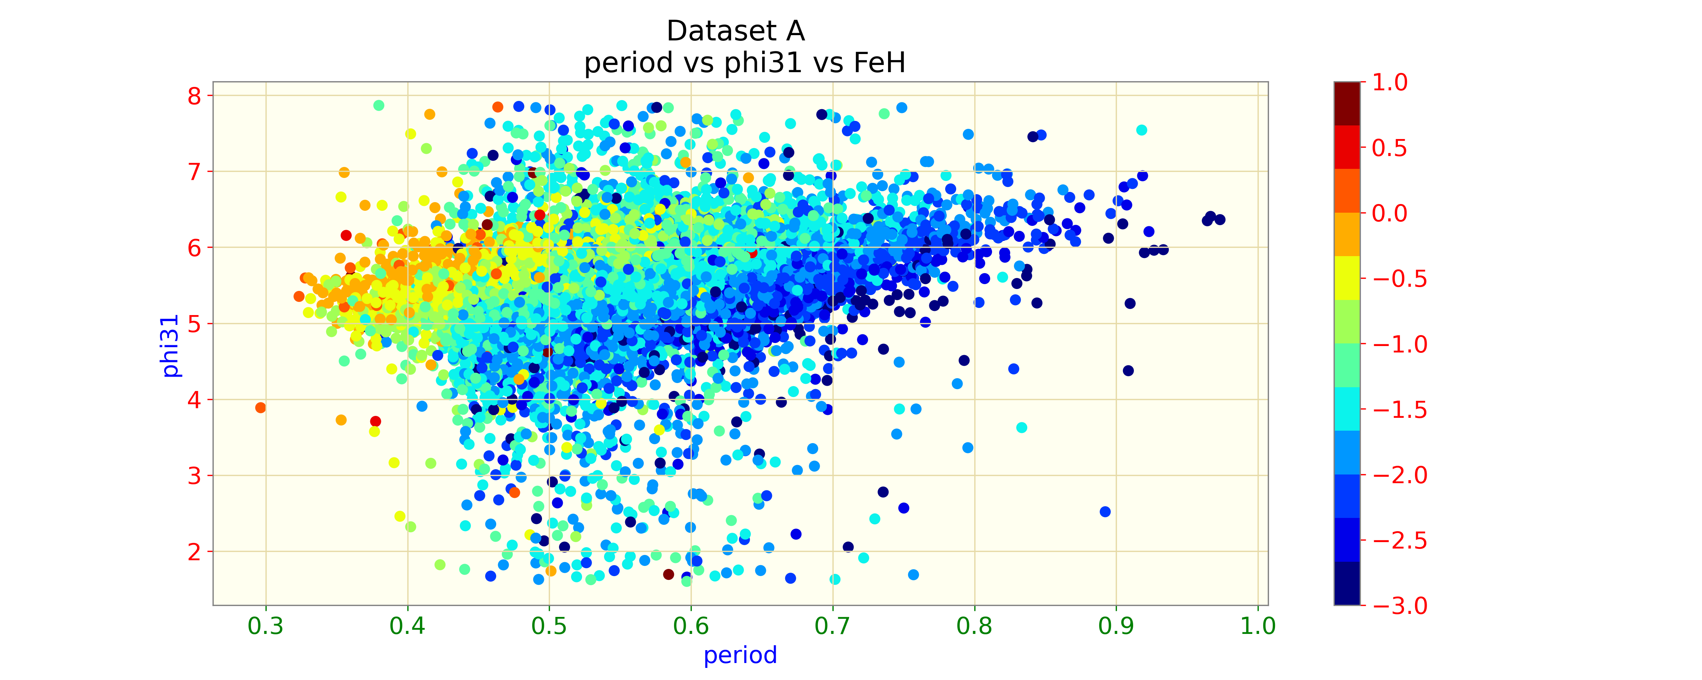
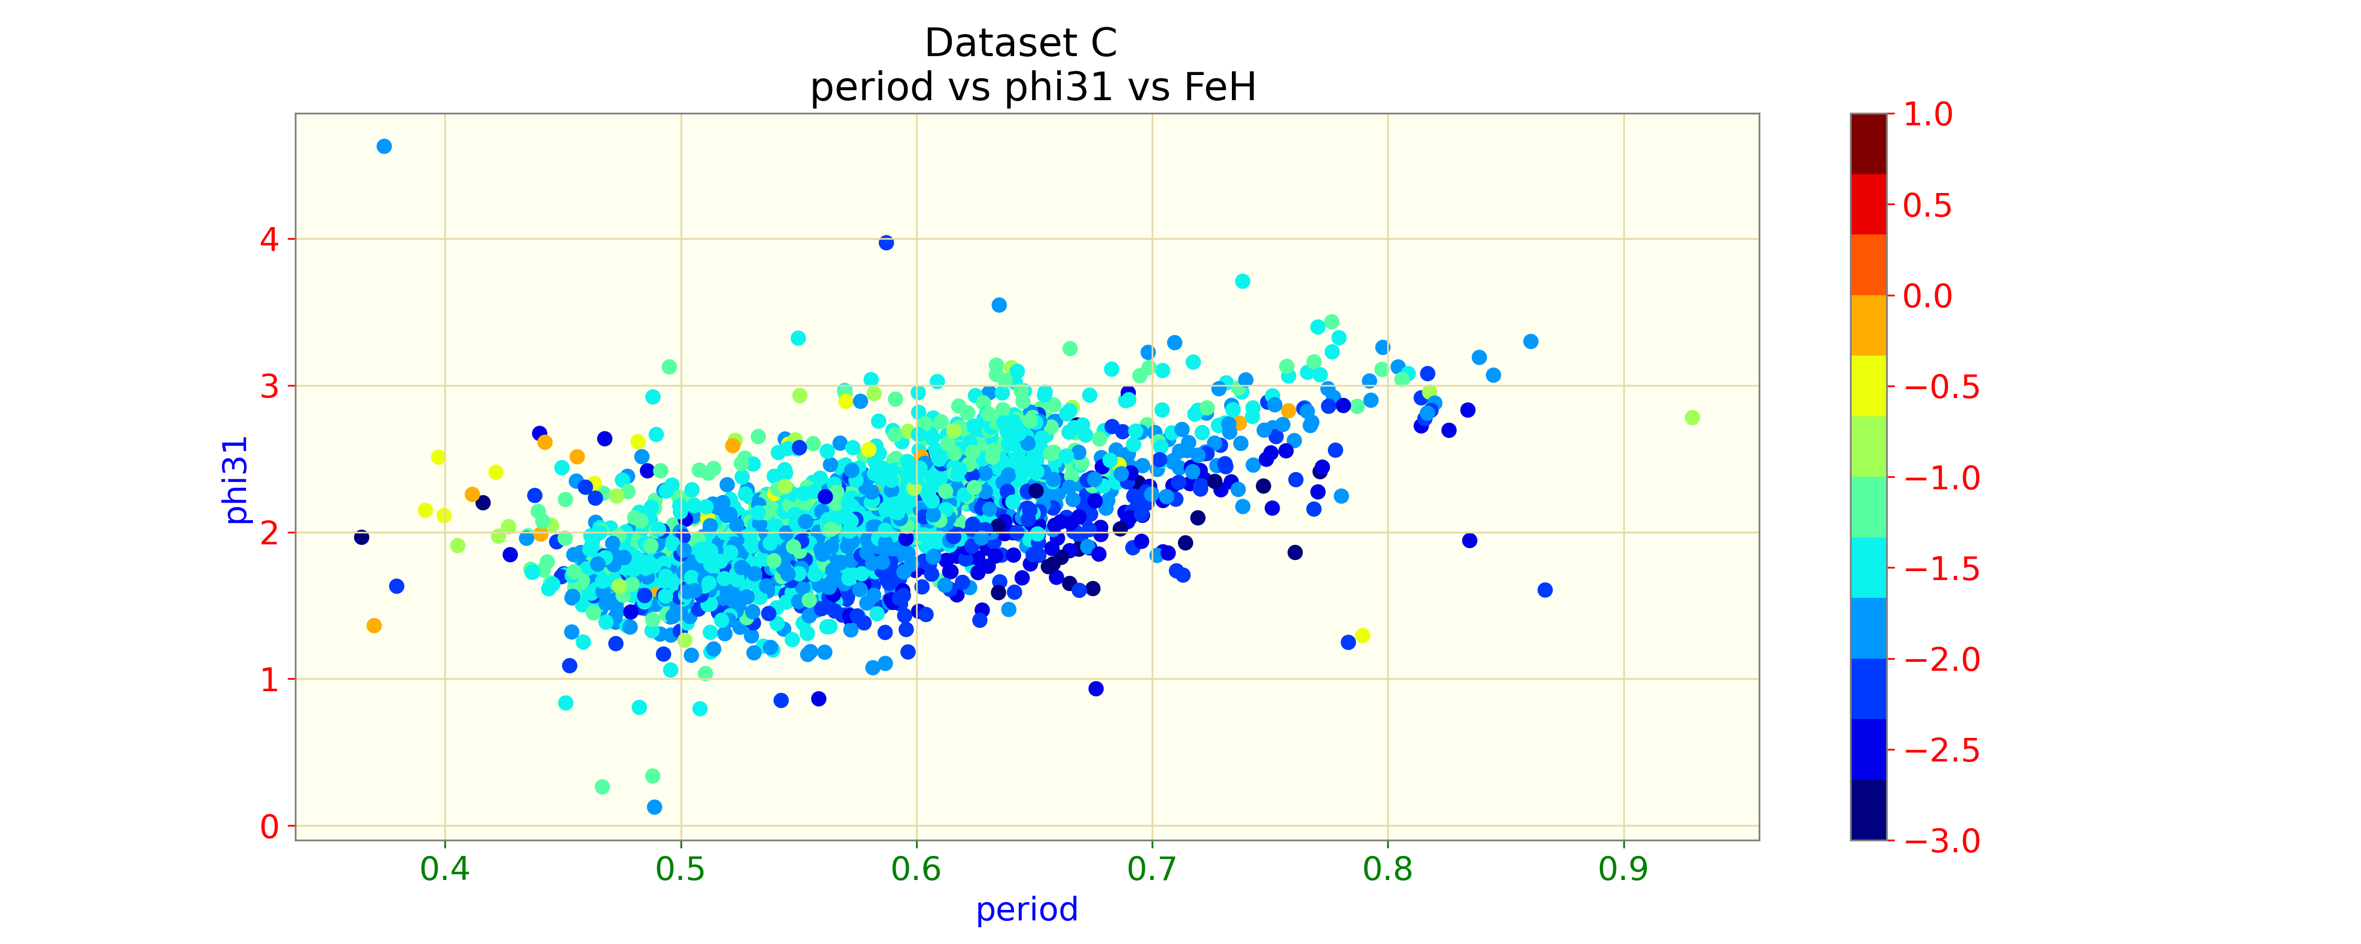
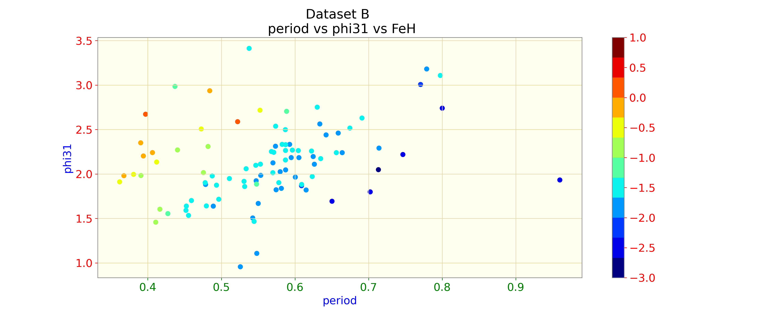
The colour-coded value is metallicity.

Slide 17

THE METHODS AND THE RESULTS

Slide 18
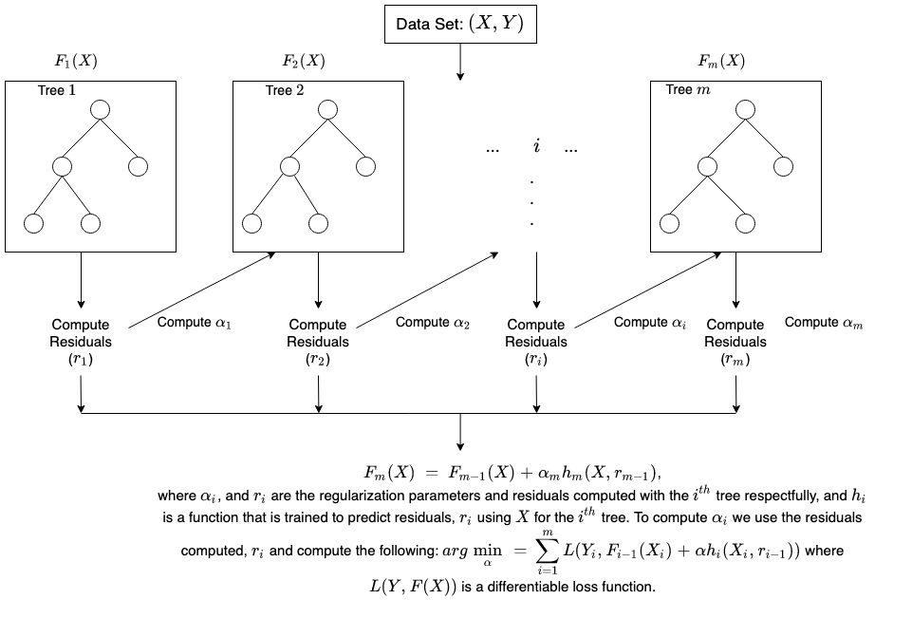
XGBoost
XGBoost, short for "Extreme Gradient Boosting" is a popular machine learning algorithm known for its high predictive accuracy and efficiency. It is an ensemble learning method that combines the predictions of multiple decision trees, iteratively improving them to minimize prediction errors.

Slide 19
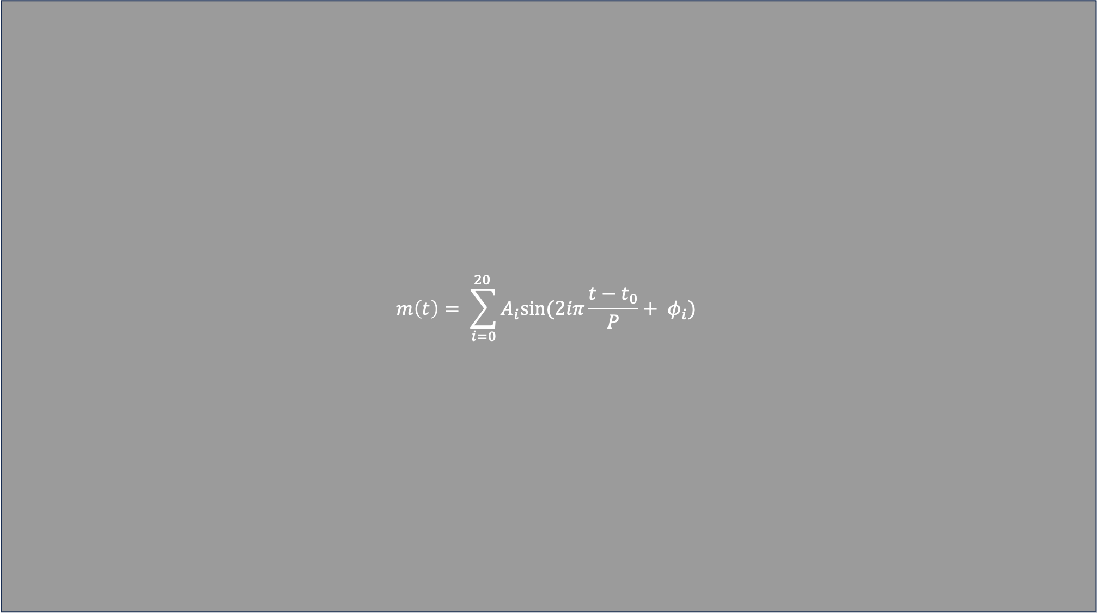
$$m\left(t\right)= \sum_{i=0}^{20 }{A_{i}sin⁡(2iπ\frac{t−t_{0}}{P}+ φ_{i})}$$
XGBoost
In our initial approach, we employed a machine learning methodology to evaluate the potential of predicting the metallicity of RRL stars, utilizing their Fourier Transform parameters, with the aid of a robust model such as XGBoost. Our process involved meticulously partitioning 70% of the dataset, followed by subjecting it to k-fold cross-validation and an extensive hyperparameter tuning regimen.
$$\left\{P, A_{i}, φ_{i1}= φ_{i}−iφ_{1}| i=1, 2, 3\right\}$$

Slide 20
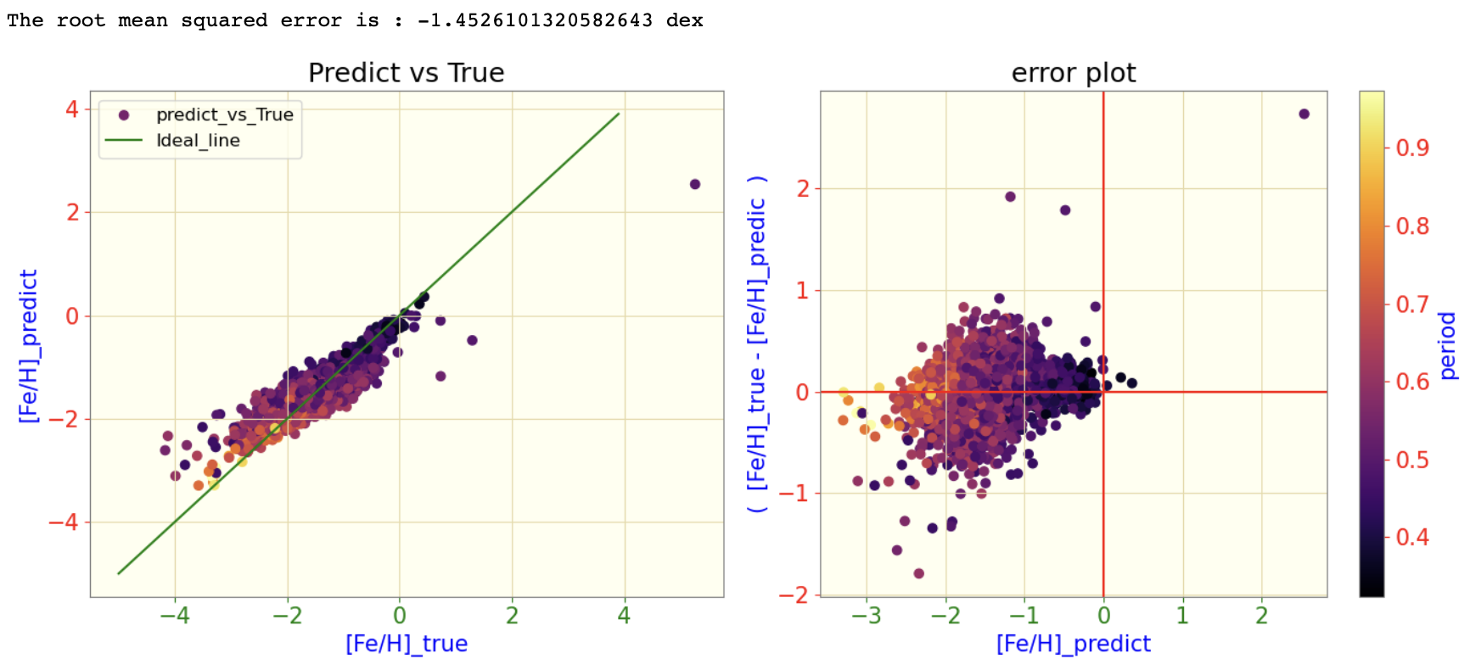
XGBoost Result On the the dataset A:

Slide 21
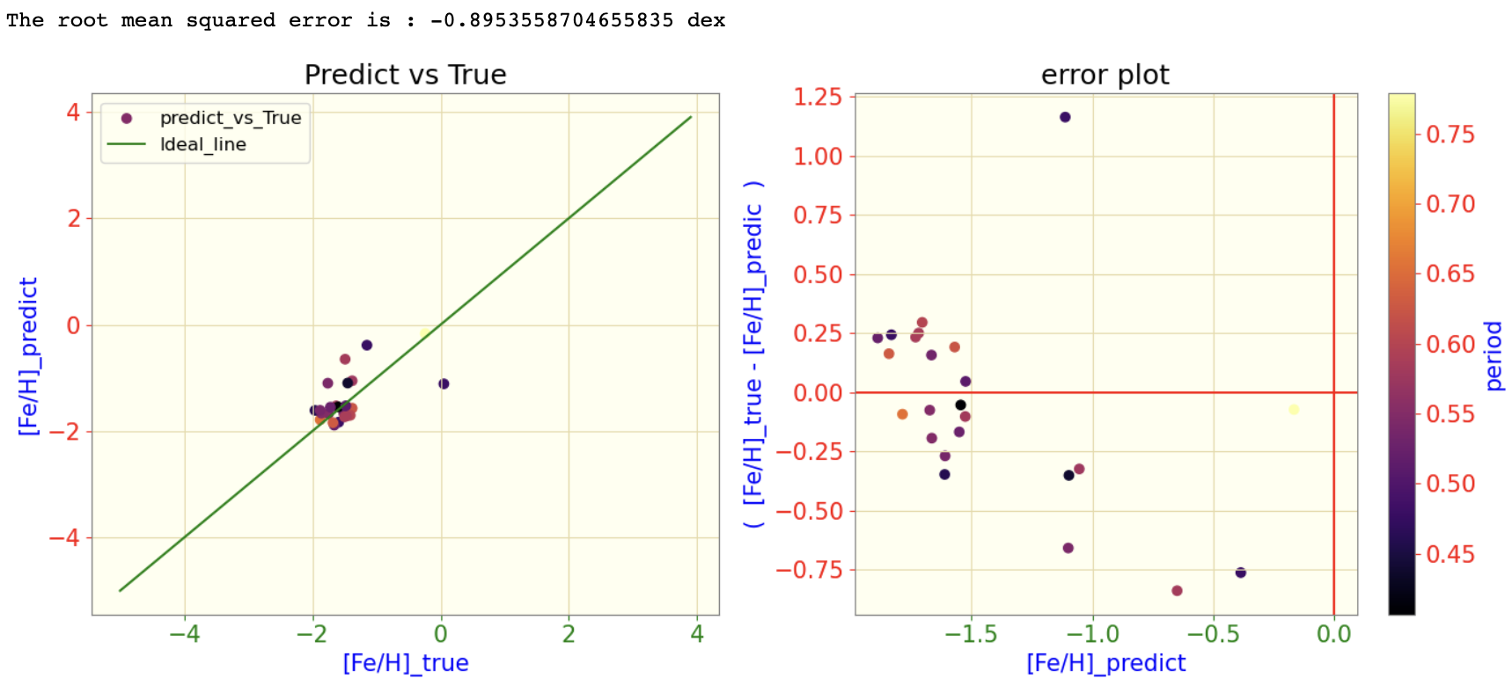
XGBoost Result On the the dataset A:

Slide 22
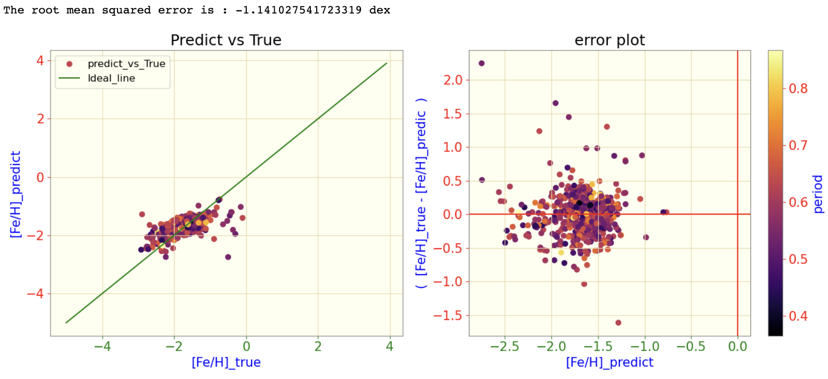
XGBoost Result On the the dataset C:

Slide 23
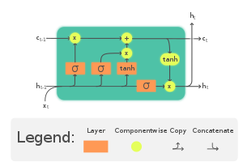
The Long Short-Term Memory Recurrent Neural Network:

Slide 24
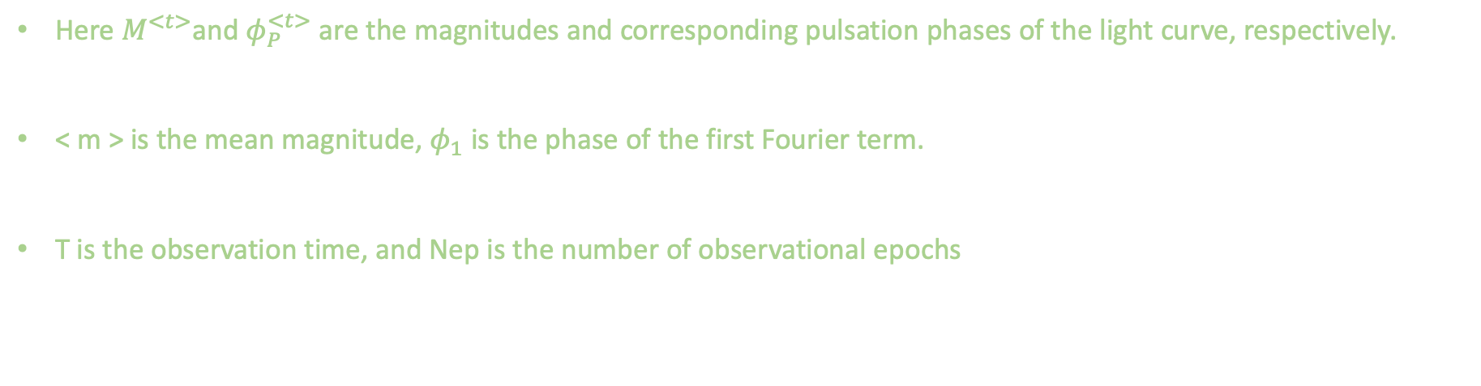

The input to the LSTM model:
$x^{<t>}= \left({m^{<t>}− <m> \atop φ_{P}^{<t>} . P}\right)$ t = {1, 2, …., $N_{ep}$}
$$φ_{P}\left(T\right)=mod[(T+P .\frac{φ_{1}}{2π/P})]$$
Here $M^{<t>}$and $φ_{P}^{<t>}$ are the magnitudes and corresponding pulsation phases of the light curve, respectively.
< m > is the mean magnitude, $φ_{1}$ is the phase of the first Fourier term.
T is the observation time, and Nep is the number of observational epochs

Slide 25
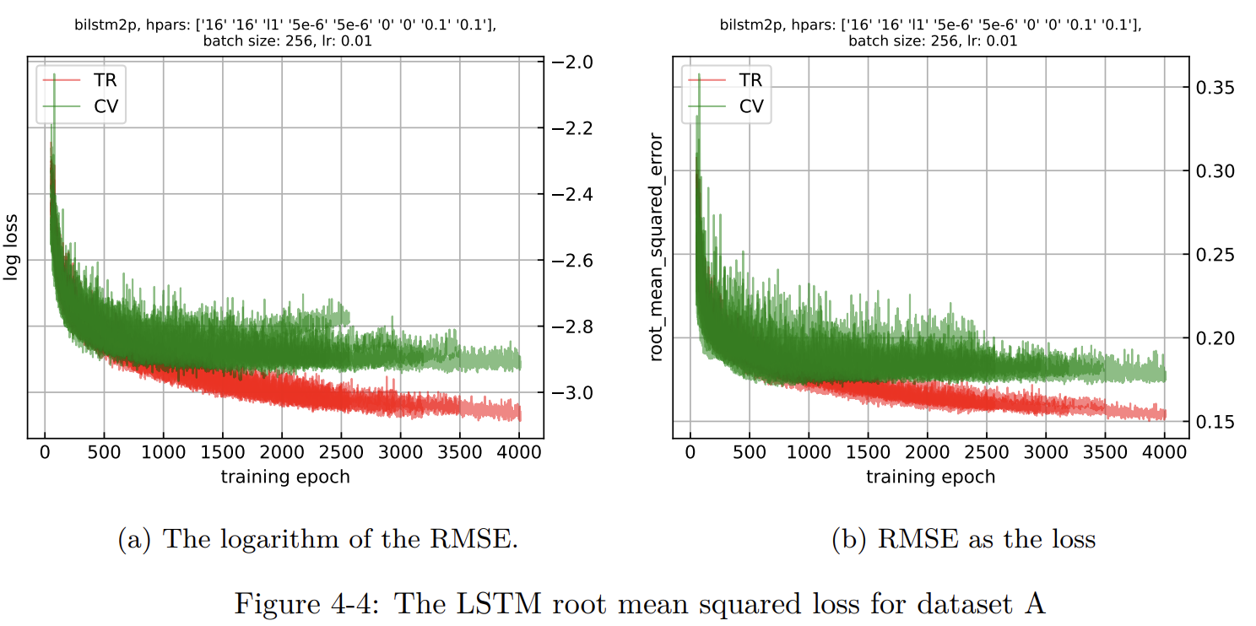
Training the LSTM model:
We trained our model using G band light curves from the ’A’ dataset, paired with their corresponding metallicities calculated using the D21 formula as the response variable.

Slide 26
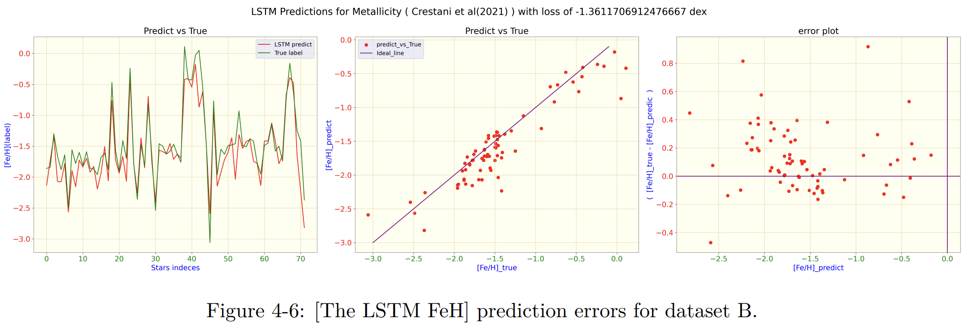
Predicting with the LSTM model:
We used the pre-trained model to predict the metallicity of G band data (dataset B). This involved processing the G band light curves using the lcfit package to obtain the phase-folded light curves.
This prediction yielded a root-mean-squared loss of -1.36 dex.

Slide 27
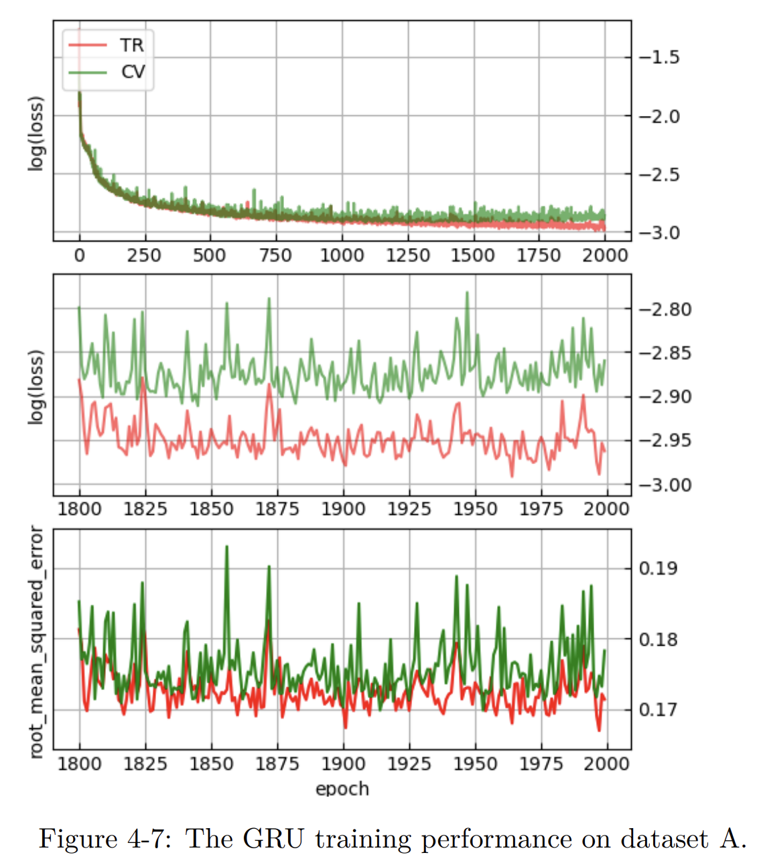
Training the GRU implementation:
In this section, we transitioned from using an LSTM model to a GRU model, while maintaining both the same number of layers and the two-dimensional input.
Similar to the LSTM model, we trained the model on dataset ’A’, which underwent preprocessing with the lcfit package.

Slide 28
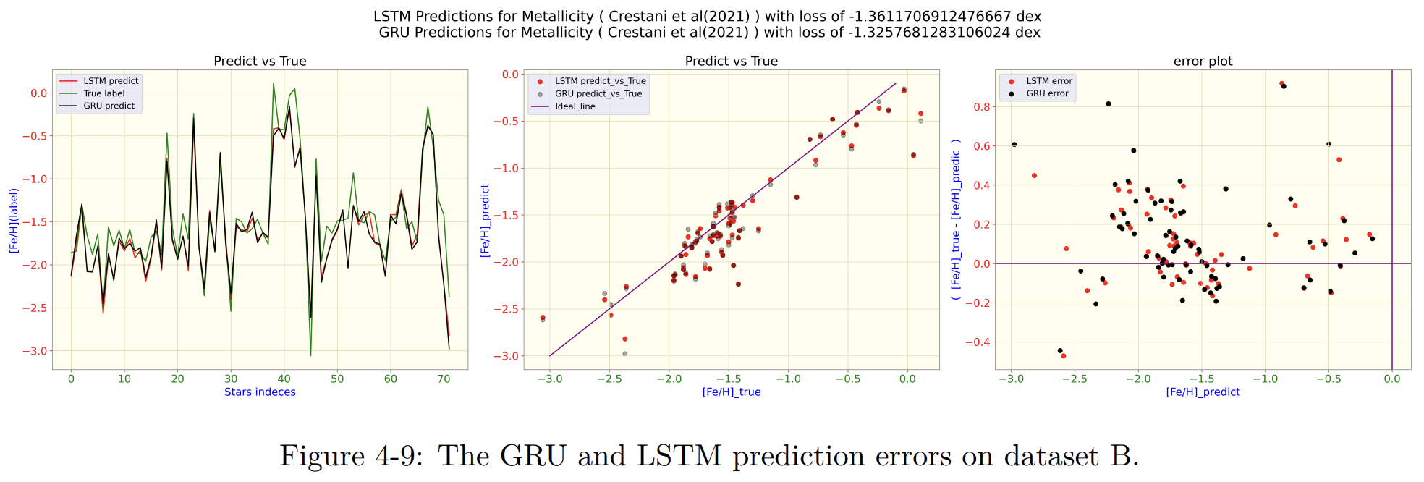
Predicting with the GRU model:
We employed this model to make predictions on dataset B . The root-mean-squared error obtained in this evaluation was -1.32 dex. This implementation stemmed from our curiosity about whether a computationally more efficient model like GRU could capture the relationship between light curve shape and metallicity in RRL stars. As a result, our findings, as depicted in the figures below, indicate that these two models showed almost similar levels of accuracy. This implies that, for future implementations, a GRU model may serve as an efficient alternative for RRL [FeH] estimation, requiring fewer computational resources compared to LSTM.

Slide 29
Transfer learning:
As mentioned earlier, the LSTM model trained on dataset "A" struggled to accurately predict metallicity in dataset B. This suggests that the model has not fully grasped how metallicity changes based on the shape of light curves for some RRL stars. Therefore:
We trained the model on dataset A and saved the best model and the weights.
We loaded the model and froze the weights in the hidden layers in order to avoid updating them during the re-training of the model on dataset B.
We kept the first and the last layer of the model trainable, which means they will update and learn the data.

Slide 30
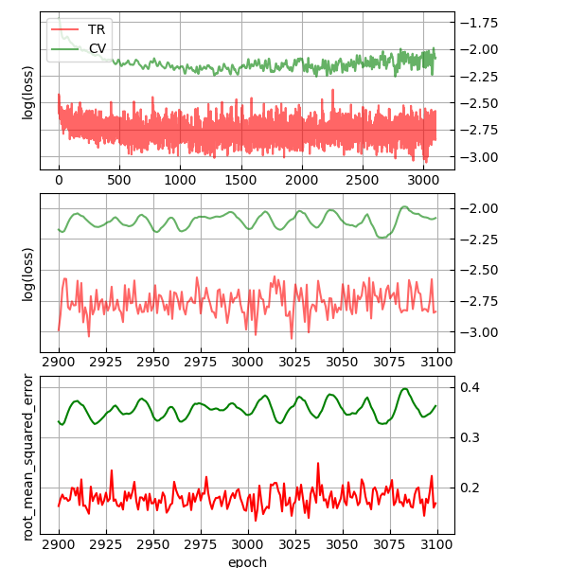
Transfer learning:
For training:
we selected 70% of the 95 light curves from the B dataset. This 70% allocation was thoughtfully divided into both training and validation datasets using the robust k-fold cross-validation methodology.

Slide 31
Transfer learning:
For Testing the model:
We predicted the entire database B because we believed the frozen layers in the model were not familiar with the trained data. This way we calculated the root-mean-squared error of -1.50 dex.
We have also tested the Transfer Learnt LSTM (TL LSTM) on 38 light curves which was never seen by the model.

Slide 32
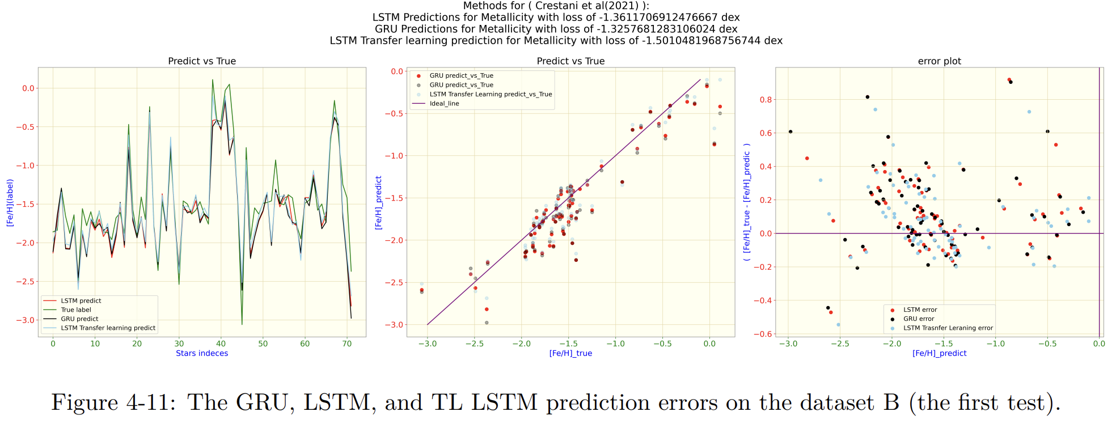
Transfer learning:
Test A:

Slide 33
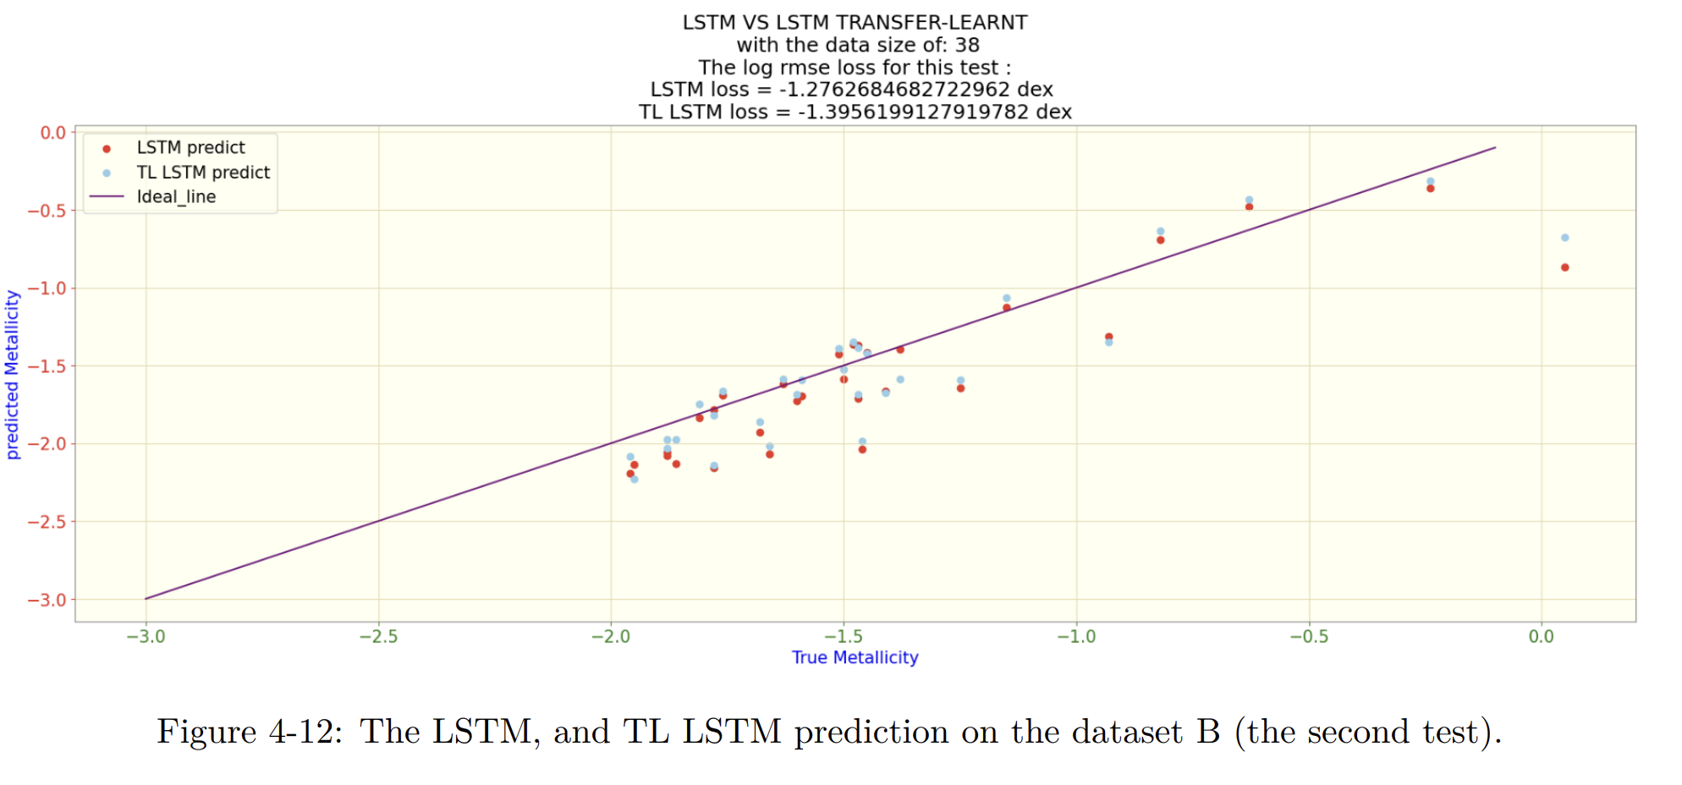
Transfer learning:
Test B:

Slide 34

Conclusion

Slide 35
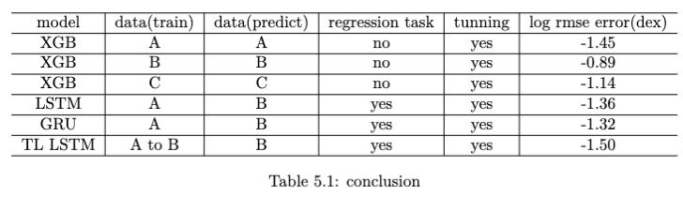
Conclusion:
Note: The XGBoost task was different from others.

Slide 36
Future Research Directions
Conduct transfer learning on the GRU model to discern the distinctions in error rates between Transfer Learning (TL) LSTM and TL GRU.
Conducting transfer learning across diverse datasets to ensure comprehensive capture of even subtle variations within the light curve patterns.
It is imperative to develop a web application or website that serves as a research platform, granting scientists access to a comprehensive repository of cutting-edge models from various academic publications. Additionally, providing seamless access to Gaia and OGLE databases to extract light curves is essential for facilitating thorough comparative analyses of distinct models pertaining to metallicity estimation across various spectral bands.

Slide 37

Appendix

Slide 38
What is the D21 model?
D21, denoted as a model in accordance with the publication by Dékány et al. (2021), encompasses the following sequential components:
Gaussian Process Regression: Although the traditional direct Fourier fitting (DFF) provides a good generic model representation of periodic light curves, it shows considerable volatility in the case of uneven phase sampling and/or noisy photometry, in which cases it lacks a good bias-variance trade-off at any choice of Fourier order. For modelling the intrinsic shape of the light curves, A GPR model was employed, utilizing a kernel formed as the product of an exponential sine-squared function and a constant kernel. To account for observational noise in the model, they also incorporated a white-kernel component. : The GPR model was transformed into the Fourier parameter space by evaluating the mean of the predictive GPR distribution over a dense equidistant phase grid and fitting a 20-order Fourier sum to the resulting points.
Principal Component Analysis: Reducing the number of variables of a data set naturally comes at the expense of accuracy, but the trick in dimensionality reduction is to trade a little accuracy for simplicity. The traditional Fourier decomposition discussed above provides a simple and intuitive parametric representation of the RR Lyrae light curves; however, the amplitudes and phases of different orders show strong correlations, which might complicate feature selection and affect predictive performance

Slide 39
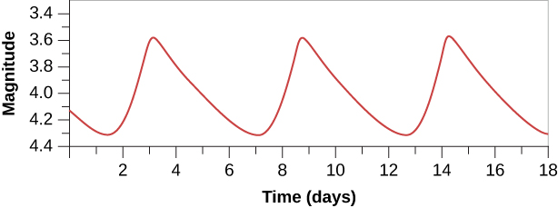
What is the D21 model?
D21, denoted as a model in accordance with the publication by Dékány et al. (2021), encompasses the following sequential components:
3. Bayesian Regression for Metallcity estimation from the PCA result: This training was performed on the I band dataset A by Dékány et al. (2021). In this project, we have collected these metallicity estimations with the I band light curves in order to provide a regression from the G band light curves of the same dataset to the collected metallicities from D21.
LCFIT
D21
GPR
FT
PCA
Time series light curves
Bayesian regression
[Fe/H]

